Slide 1

log-on functionality
basic intro
START

Slide 2
CONTENTS
1
2
Intro of feactures
My consideration
3
4
Future implementation
Effect display

Slide 3
1
Intro of features

Slide 4

1
Intro of features
features of log on
My basic task is to implement a basic login function. Due to the limited database conditions, our APP is a software with high privacy requirements. After weighing many problems, I simply use Firebase's authentication function to verify the user's user name and password. Therefore, the account password is issued by the company to ensure security.

Slide 5
2
My consideration

Slide 6

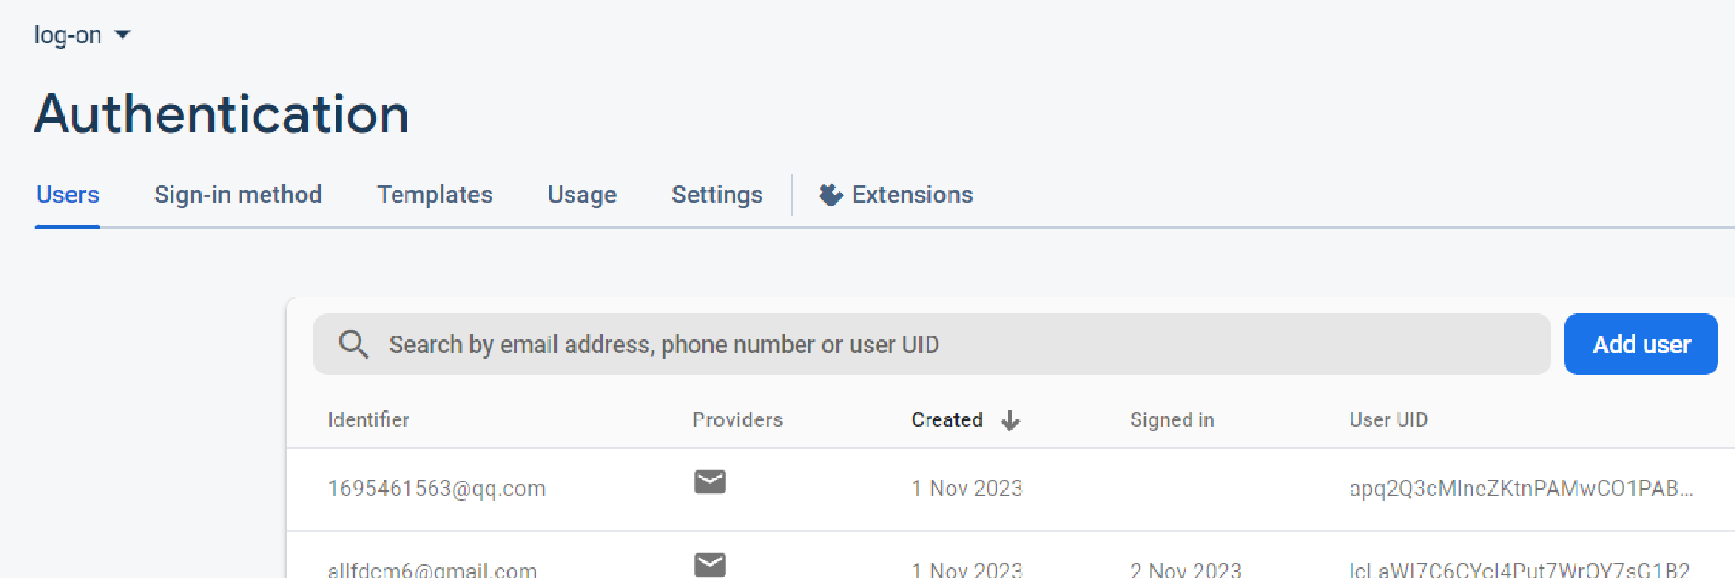
2
Navelink and my consideration
The basic log on function need sign up first and communication with Server, session management and security best practices etc. But based on navelink’s speciality and this app need more privacy. This app use a closed database , the company provides and issues an account in a unified manner, and the password of the account login mailbox and registration is used.

Slide 7
3
Basic knowledge

Slide 8
3
NO.1
NO.2
NO.3
User interface design
(Use kotlin and jetpack compose)
This basic login information is generated using the authenratiom function of firebase
Connect the front-end and back-end and set a navigation to the main activity

Slide 9
3
Future implemantation
Keep the user logged in
To achieve user logout and re-login function
Use open source registration features to expand the range and ways of logging in(For example, mobile phone number login)
Security verification, man-machine verification.

Slide 10
4
Effect display

Slide 11
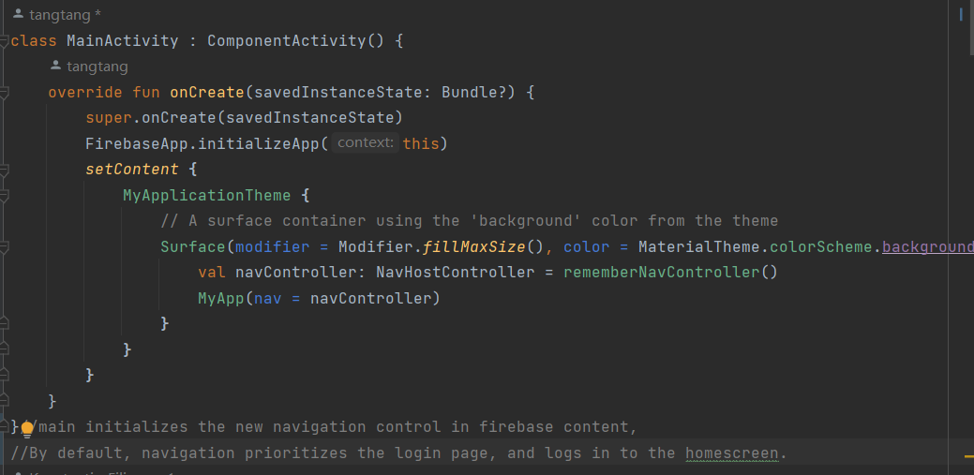
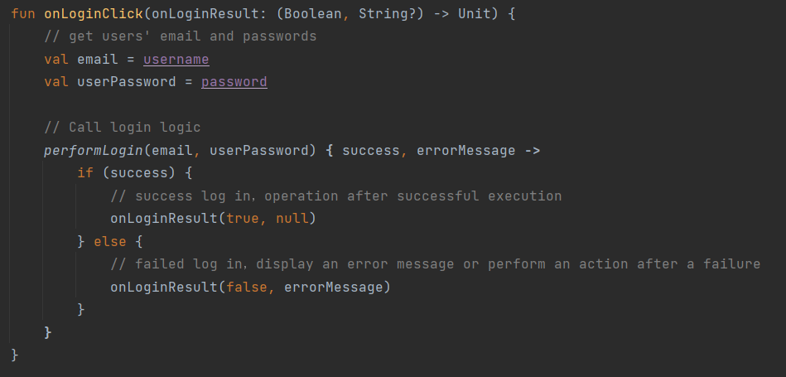
Main code

Slide 12
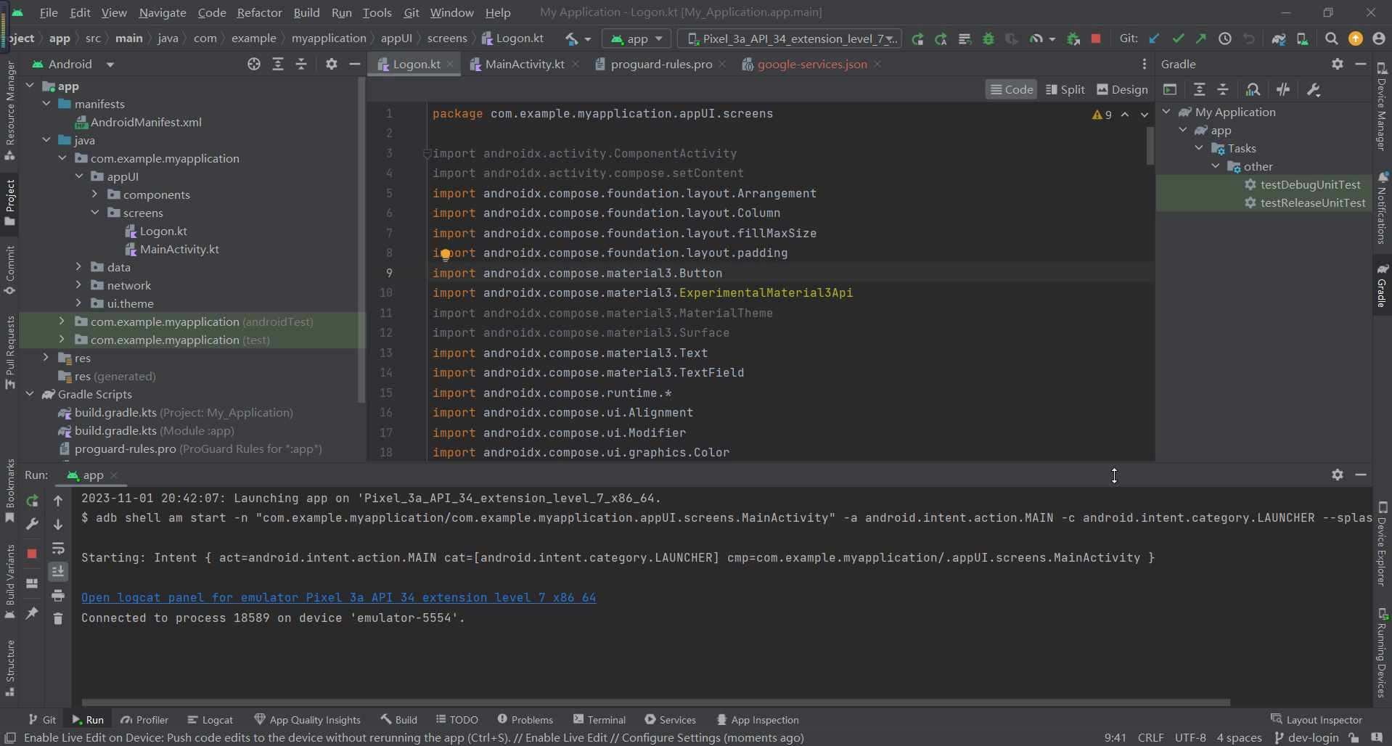
6
Effect display

Slide 13
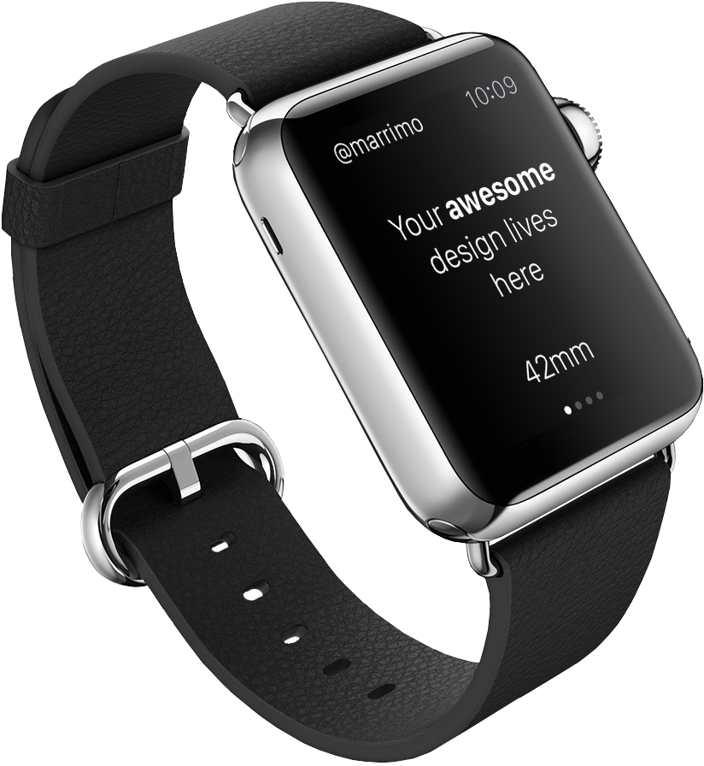
thanks
GOOD BYE

